Slide 1

OPERATING SYSTEMS UNIT-4
CONCURRENCY CONTROL AND SYNCHRONIZATION

Slide 2
Concurrency and Synchronization
Concurrency
Concurrency means that multiple processes or threads make progress during the same time period.
They may not actually execute at exactly the same instant. The CPU switches between them very quickly.
Simple example
Suppose two processes are running:
  P1: Printing a document
  P2: Downloading a file
The CPU may execute them like this:
Time →
P1 P1 P2 P2 P1 P2
| | | | | |
Print Print Download Download Print Download

Slide 3
Synchronization
Synchronization is the technique used to control the execution of concurrent processes or threads so that shared resources are accessed safely.
simple words: Synchronization prevents multiple processes from incorrectly accessing shared data at the same time.
Example
P1 ──→ Critical Section ──→ Exit
↓
Resource
↑
P2 ──→ Wait ─────────────→ Enter
Only one process is allowed to access the critical section at a time.
Critical Section
A critical section is the part of a program where a process accesses or modifies shared resources/data.
Example:
// Normal code
count = count + 1; // Critical Section
// Normal code
If multiple processes execute this statement simultaneously, a race condition may occur.

Slide 4
THREADS: INTRODUCTION
A thread is a basic unit of CPU utilization;
It comprises a thread ID, a program counter (PC), a register set, and a stack.
It shares its code section, data section, and other operating-system resources with other threads belonging to the same process
A traditional process has a single thread of control.
If a process has multiple threads of control, it can perform more than one task at a time.

Slide 5
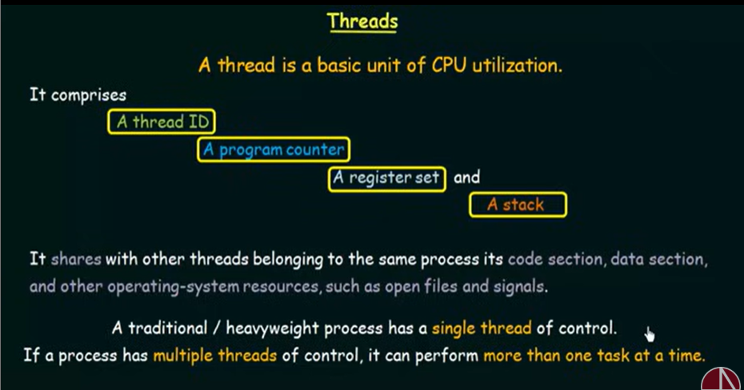
THREADS: INTRODUCTION

Slide 6
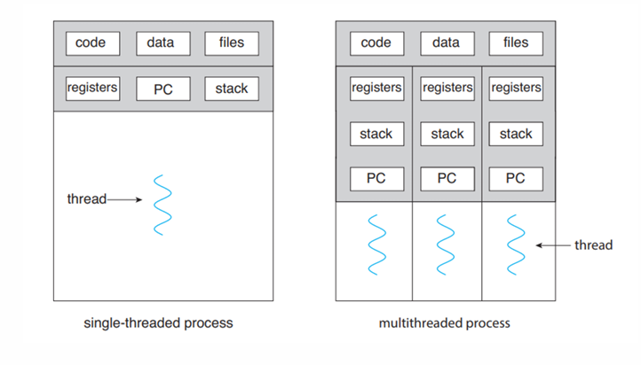
Cont..

Slide 7
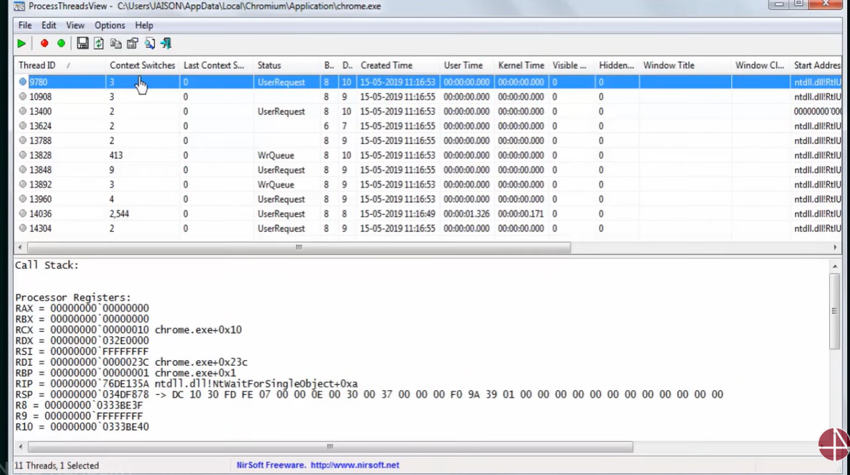
Cont..

Slide 8
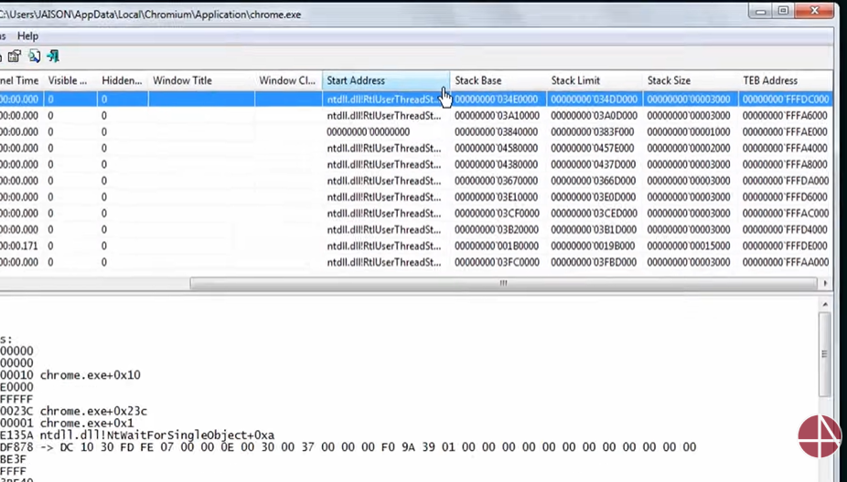
Cont..

Slide 9
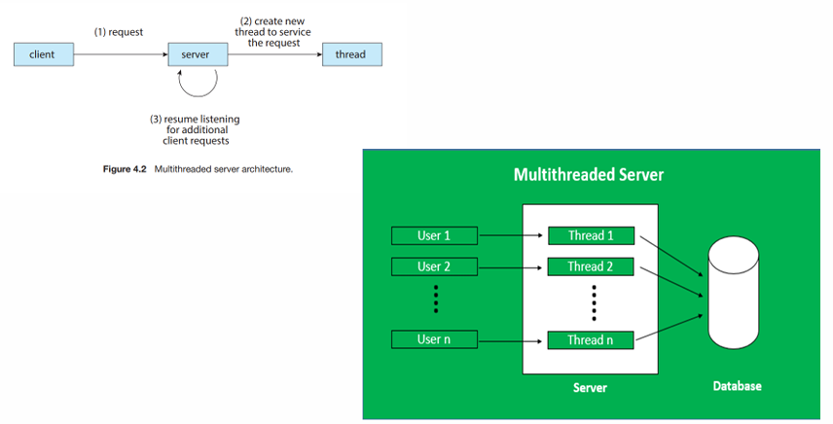
MULTI-THREADED SERVER ARCHITECTURE

Slide 10
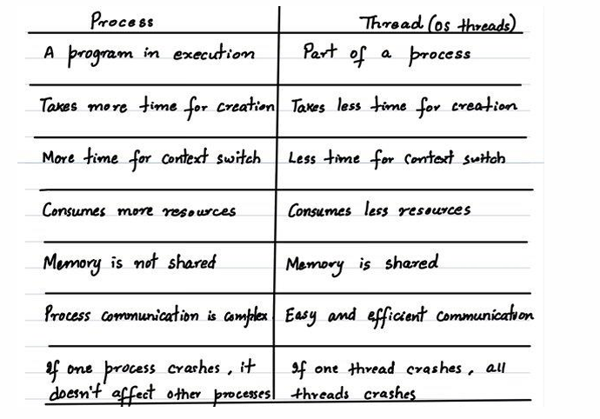
PROCESS VS THREADS

Slide 11
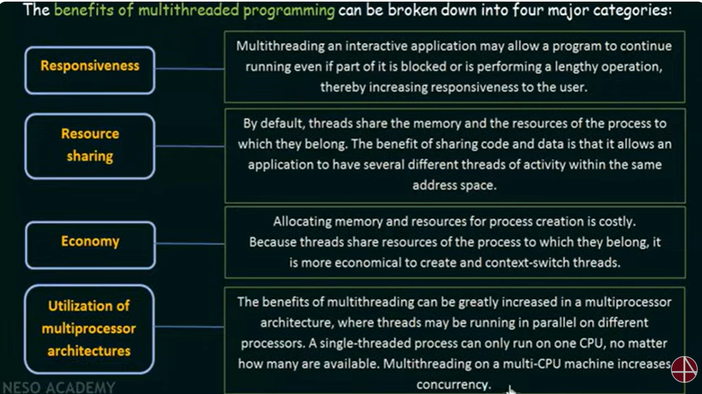
BENEFITS OF THREADS

Slide 12
TYPES OF PARALLELISM
Two types of parallelism:
1. Data Parallelism
2. Task Parallelism
1. Data parallelism:
Focuses on distributing subsets of the same data across multiple computing cores and performing the same operation on each core.
Consider, for example, summing the contents of an array of size N.
On a single-core system, one thread would simply sum the elements [0] ...[N − 1]. On a dual-core system, however, thread A, running on core 0, could sum the elements [0] . . . [N∕2 − 1] while thread B, running on core 1, could sum the elements [N∕2] . . . [N − 1].
The two threads would be running in parallel on separate computing cores.
Each processor performs the same task on different pieces data. The focus is on distributing data.

Slide 13
Cont..
2. Task parallelism
Each processor perform different tasks, possibly on different data. The focus is on distributing work.
Involves distributing not data but tasks (threads) across multiple computing cores.
Each thread is performing a unique operation.
Different threads may be operating on the same data, or they may be operating on different data.
Task parallelism might involve two threads, each performing a unique statistical operation on the array of elements. (Average, Variance, Mode etc.)
The threads again are operating in parallel on separate computing cores, but each is performing a unique operation.
Data Parallelism and Task Parallelism are not mutually exclusive and applications generally use a hybrid of these two strategies.

Slide 14
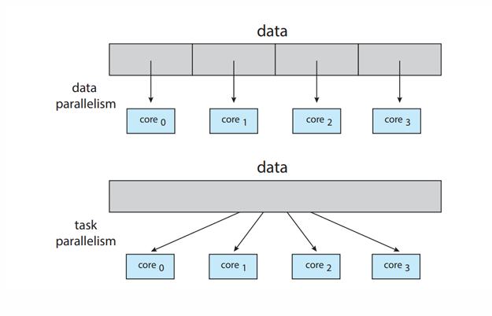
Cont..

Slide 15
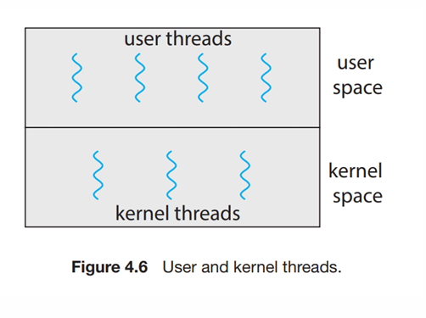
TYPES OF THREADS

Slide 16
Cont..
Support for threads may be provided either at the user
level, for user threads, or by the kernel, for kernel threads.
User threads are supported above the kernel and are
managed without kernel support
kernel threads are supported and managed directly by
the operating system.
All contemporary operating systems— including
Windows, Linux, and macOS— support kernel threads.

Slide 17
RELATIONSHIP BETWEEN KERNEL THREADS AND USER THREADS
Three common ways of establishing relationship between user threads and kernel threads:
many-to-one model
one-to-one model
many-to-many model

Slide 18
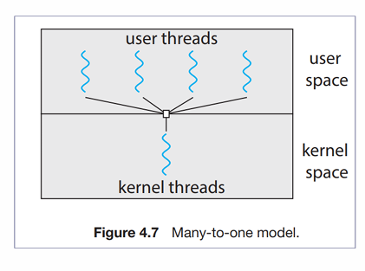
MANY -TO-ONE MODEL
Many user-level threads are mapped to
one kernel thread.
Thread management is done by the thread library
in user space, so it is more efficient.
The entire process will be blocked if a thread makes
a blocking system call.
One thread can access the kernel at a time, multiple
threads are unable to run in parallel on multicore systems.
Unable to take advantage of multiple processing cores

Slide 19
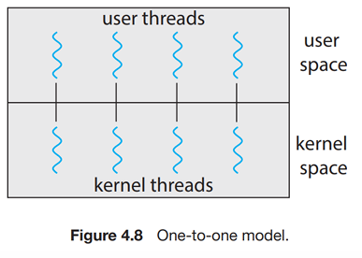
ONE-TO-ONE MODEL
Maps each user thread to a kernel thread.
Provides more concurrency than the many
to-one model by allowing another thread to
run when a thread makes a blocking system call.
It also allows multiple threads to run in parallel
on multiprocessors.
The only drawback to this model is that creating a
user thread requires creating the corresponding kernel
thread, and a large number of kernel threads may
burden the performance of a system.
Linux, along with the family of Windows operating
systems, implement the one-to one model.

Slide 20
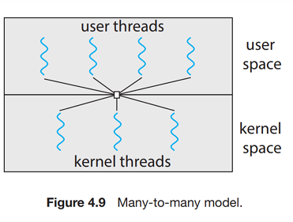
MANY-TO-MANY MODEL
The many-to-many model multiplexes many user-level
threads to a smaller or equal number of kernel threads.
The number of kernel threads may be specific to either
a particular application or a particular machine
(8 processing cores vs four processing cores)
when a thread performs a blocking system call,
the kernel can schedule another thread for execution.
More flexible, but difficult to implement
One variation on the many-to-many model that
Multiplexes many user level threads to a smaller or
equal number of kernel threads
but also allows a user-level thread
to be bound to a kernel thread.

Slide 21
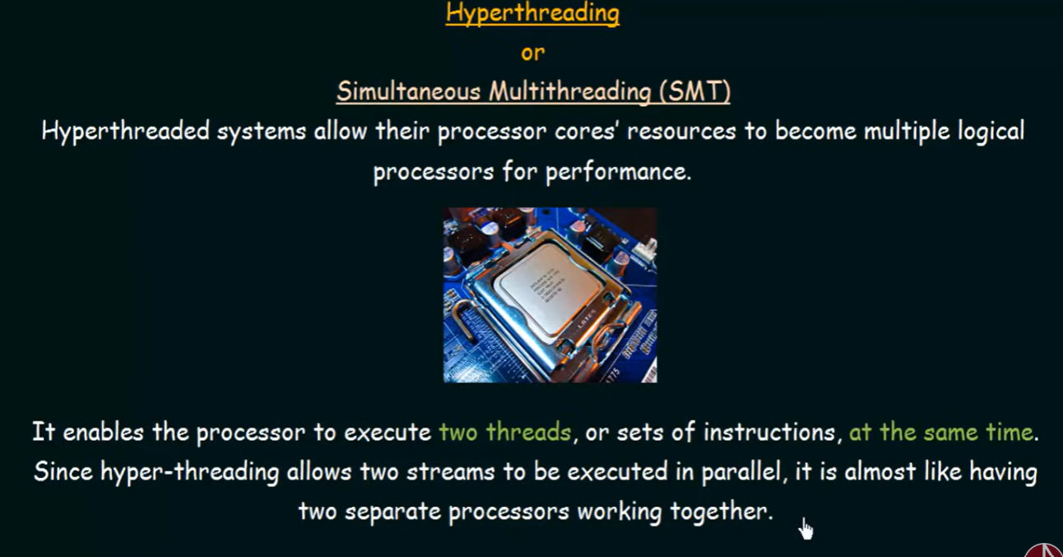
Cont..

Slide 22
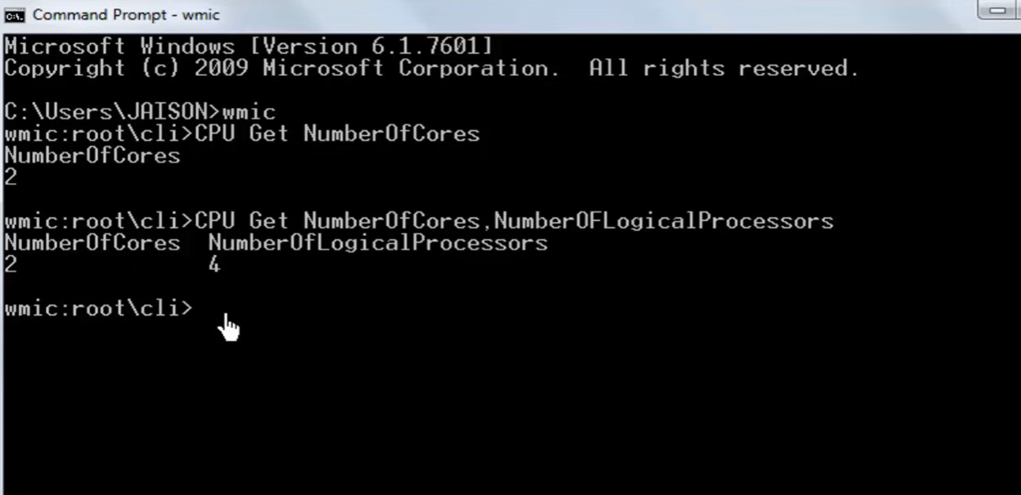
Cont..

Slide 23
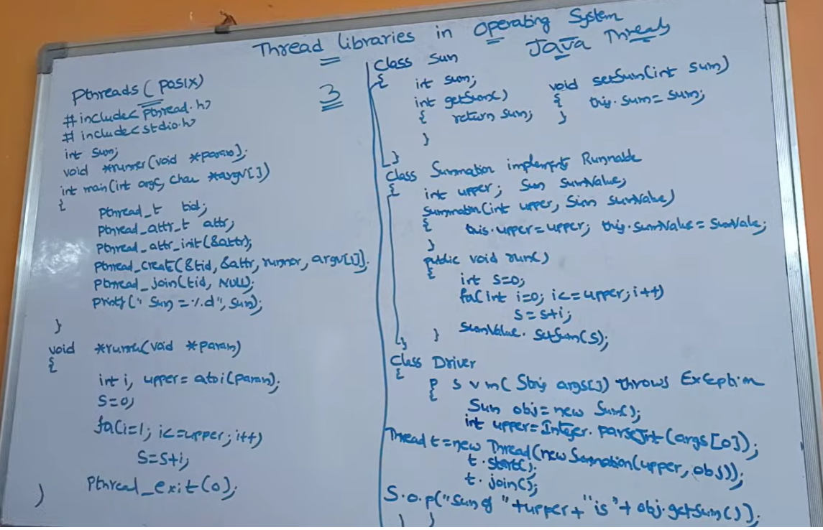
Cont..

Slide 24

THREAD APIS
An API, or application programming interface, is a set of defined rules that enable different applications to communicate with each other.

Slide 25
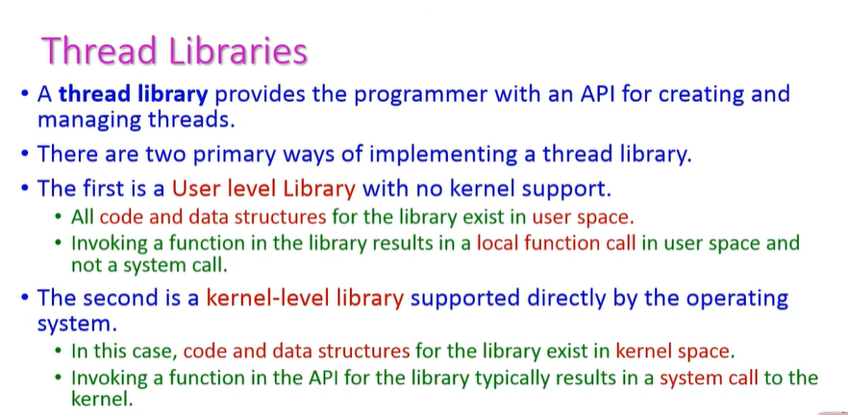
Cont..

Slide 26
Cont..
PThreads
A POSIX standard (IEEE c) API for thread creation and synchronization
API specifies behavior of the thread library, implementation is up to development of the library. Common in UNIX operating systems (Solaris, Linux, Mac OS X)
Windows Threads
Implements the one-to-one mapping.
Each thread contains a thread id, Register set Separate user and kernel stacks, Private data storage area (known as the context of the threads)
Linux Threads
Linux refers to them as tasks rather than threads • Thread creation is done through clone() system call clone() allows a child task to share the address space of the parent task (process)
Java Threads
Java threads may be created by: Extending Thread class Implementing the Runnable interface
Java threads are managed by the JVM. PROCESS SYNC

Slide 27
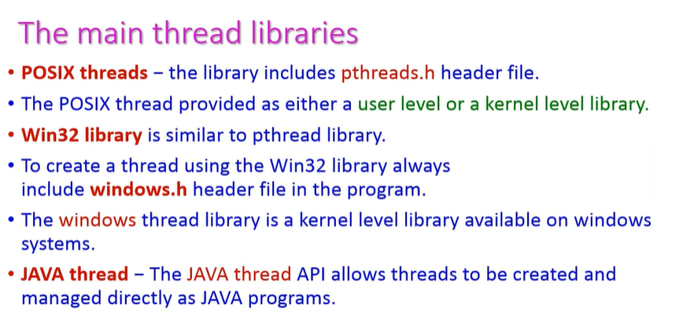
Cont..

Slide 28
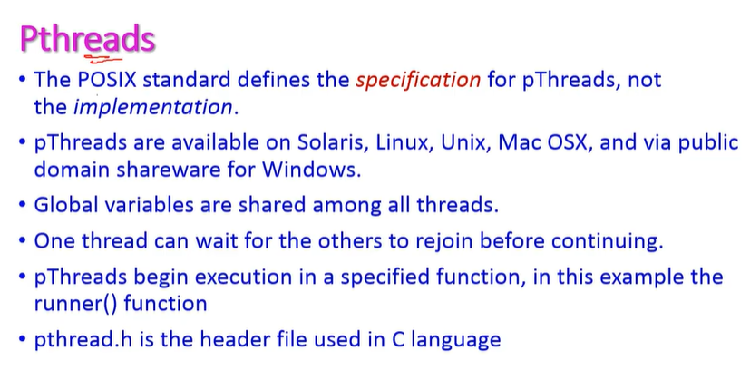
PThreads

Slide 29
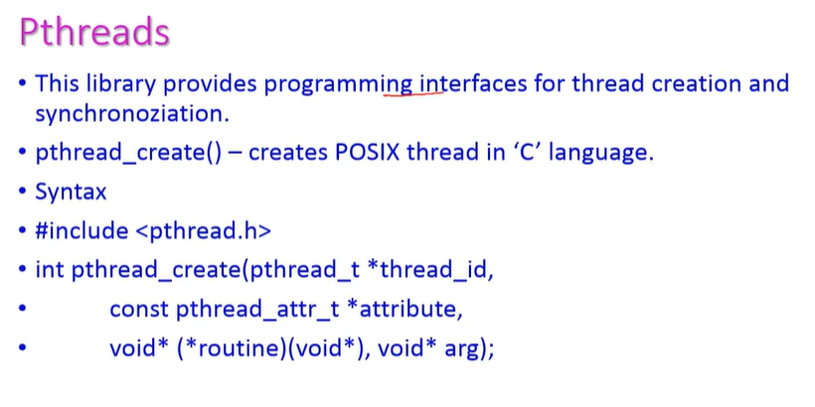
Cont..

Slide 30
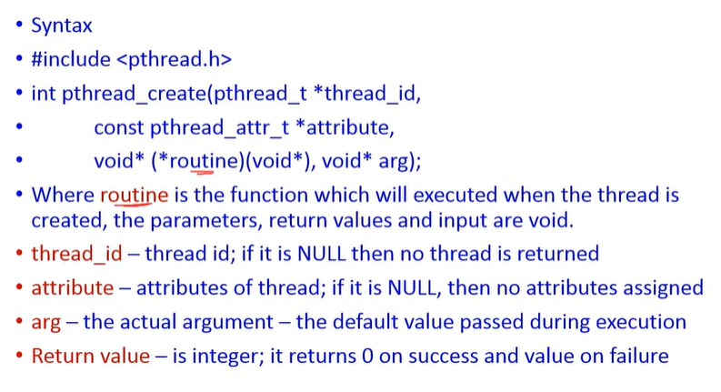
Cont..

Slide 31
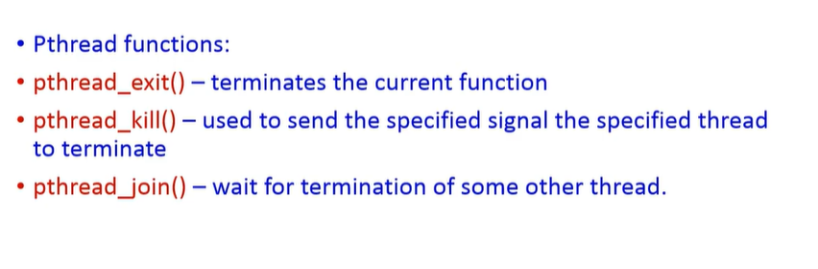
Cont..

Slide 32
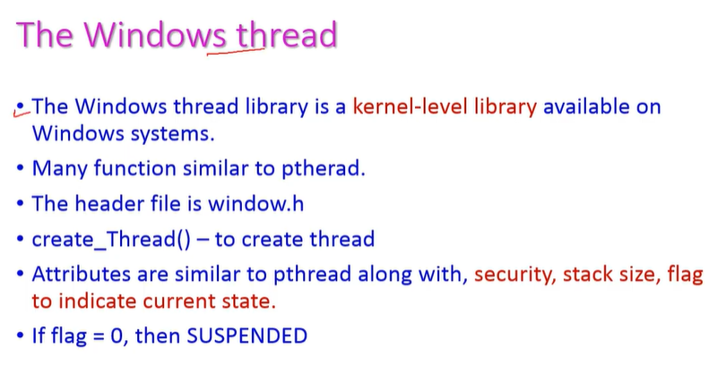
Windows Threads

Slide 33
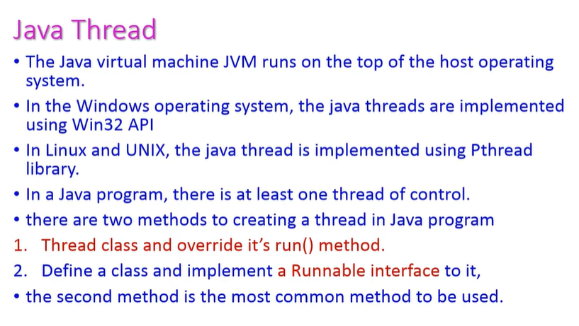
Java Threads

Slide 34
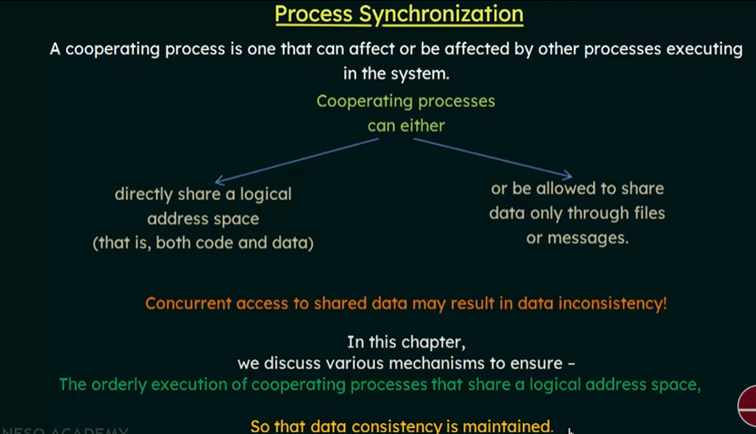
PROCESS SYNCHRONIZATION

Slide 35
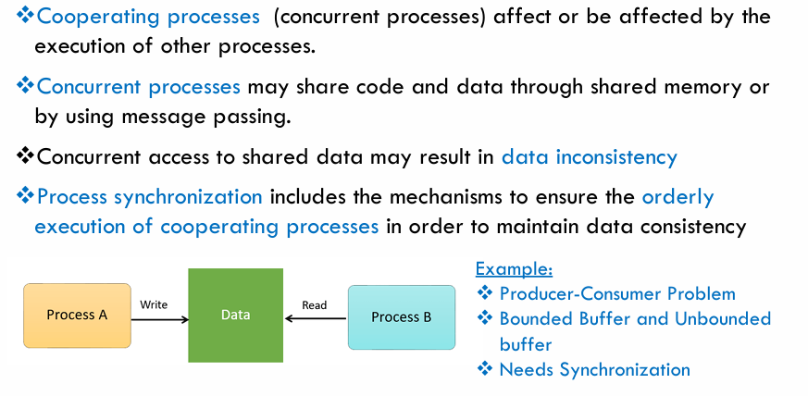
Cont..

Slide 36
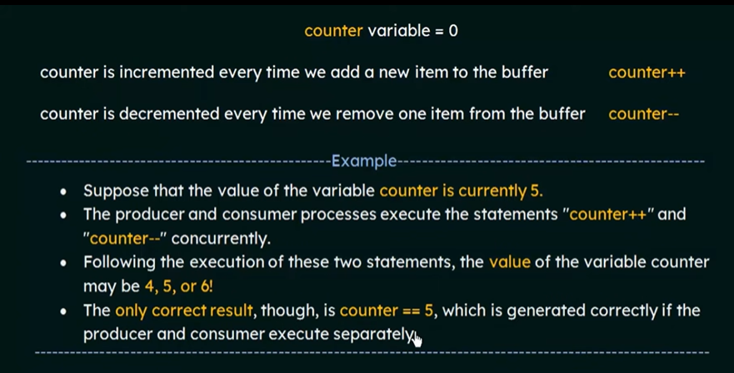
LACK OF SYNCHRONIZATION: ISSUES

Slide 37
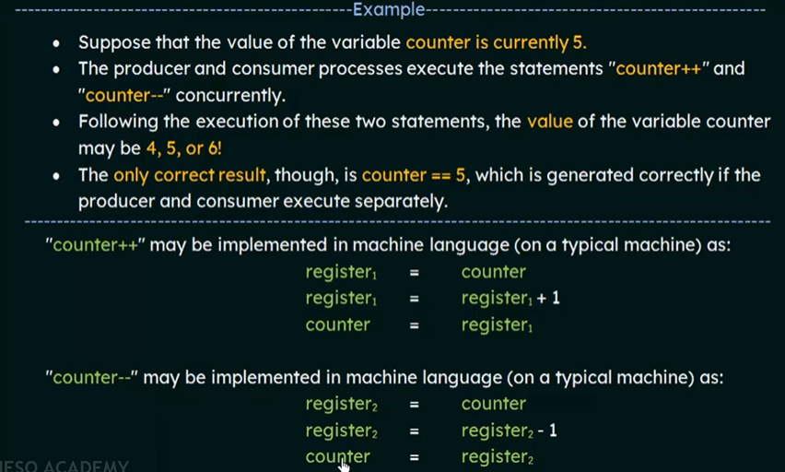
Cont..

Slide 38
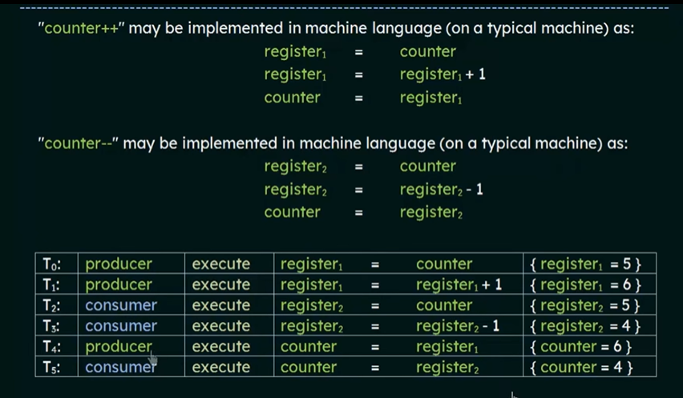
Cont..

Slide 39
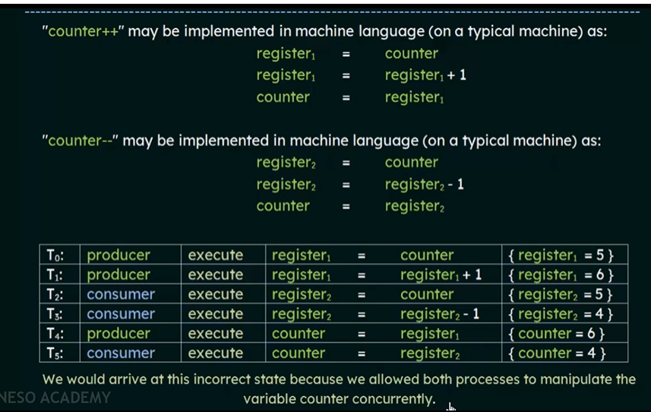
Cont..

Slide 40
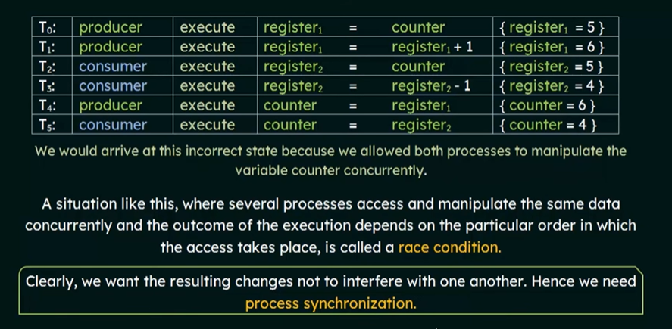
Cont..

Slide 41
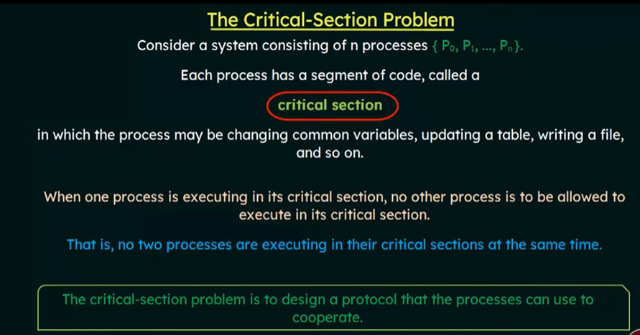
CRITICAL SECTION PROBLEM

Slide 42
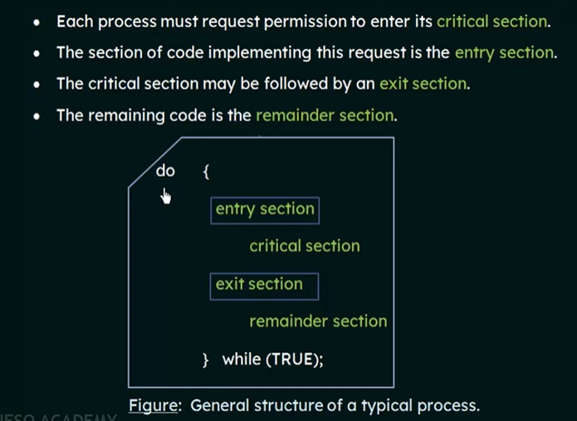
Cont..

Slide 43
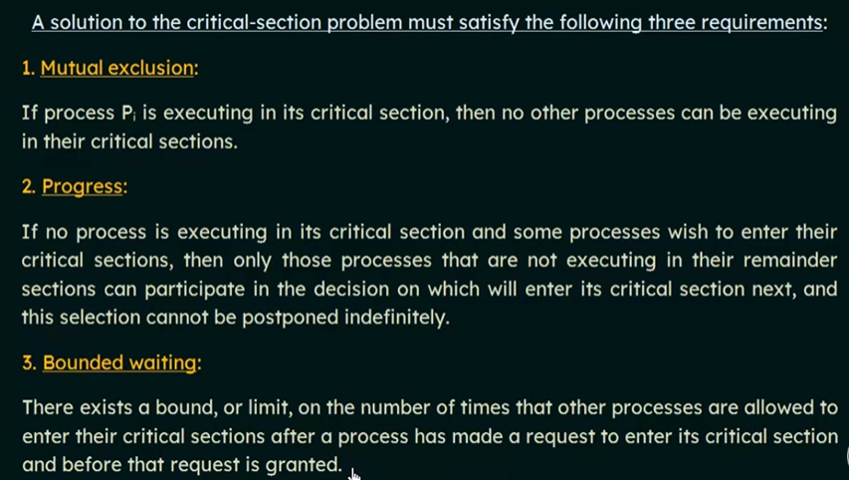
CRITICAL SECTION: SOLUTION REQUIREMENTS

Slide 44
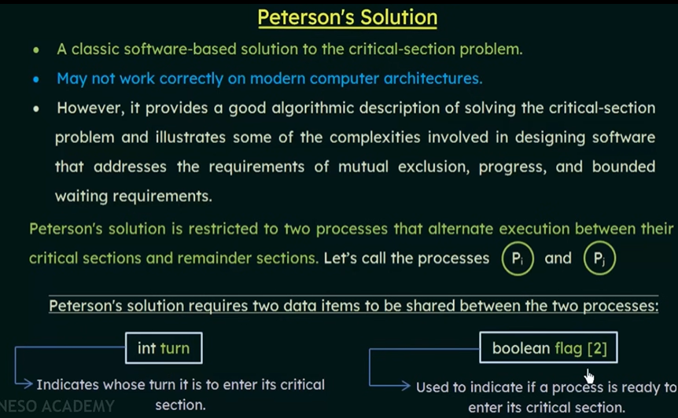
CRITICAL SECTION: PETERSON’S SOLUTION

Slide 45
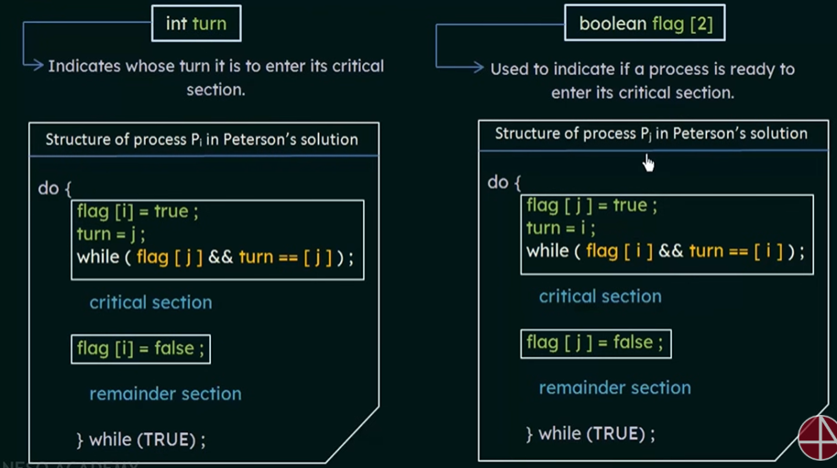
CRITICAL SECTION: PETERSON’S SOLUTION

Slide 46
CRITICAL SECTION: PETERSON’S SOLUTION-CONSTRAINT SATISFACTIO

Slide 47
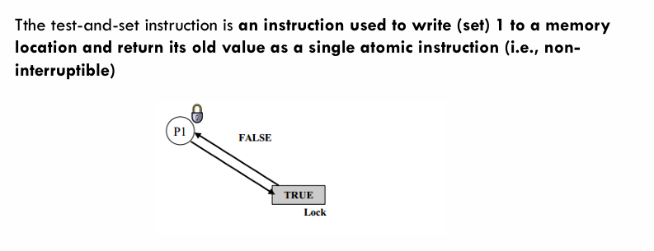
CRITICAL SECTION: TEST AND SET Lock SOLUTION

Slide 48
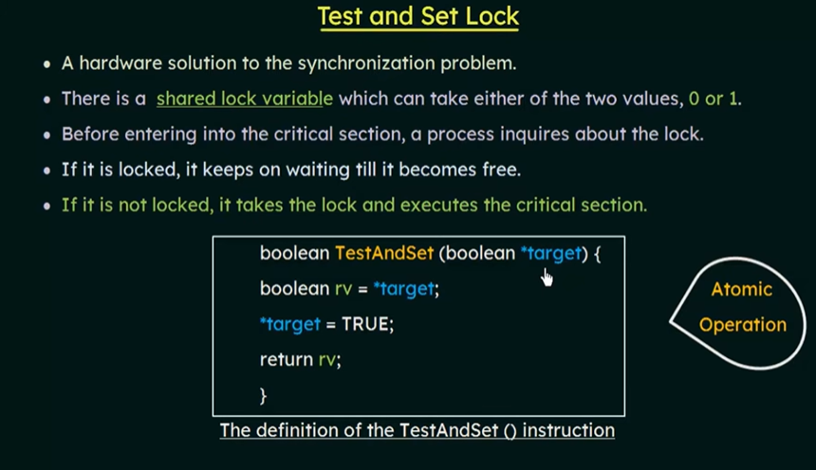
CRITICAL SECTION: TEST AND SET Lock SOLUTION

Slide 49
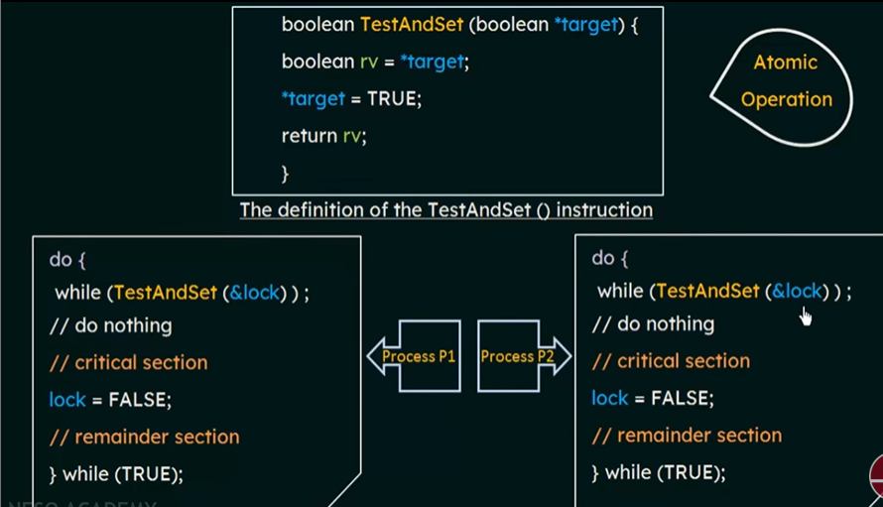
Cont..

Slide 50
Cont..
advantage
Satisfies mutual-exclusion.
Does not satisfy bounded-waiting.

Slide 51
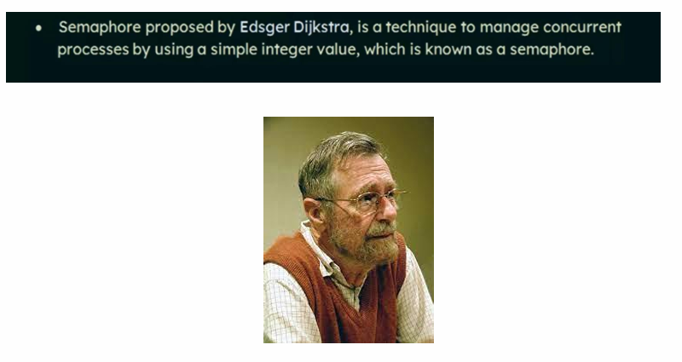
SEMAPHORES

Slide 52
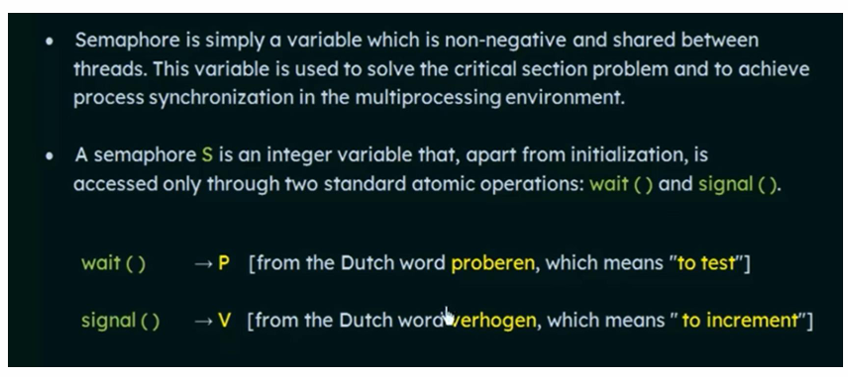
Cont..

Slide 53
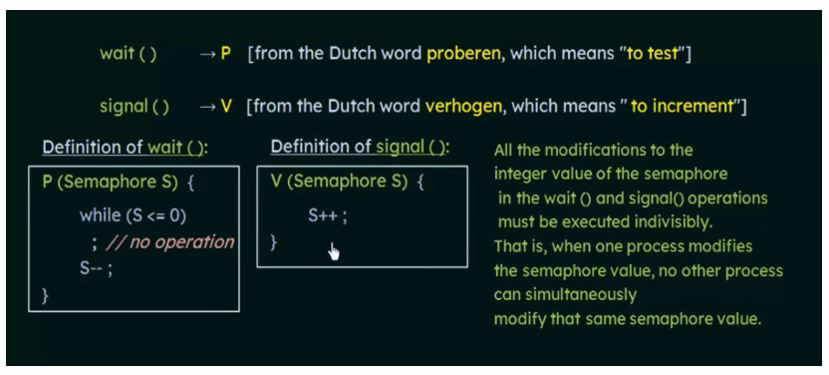
Cont..

Slide 54
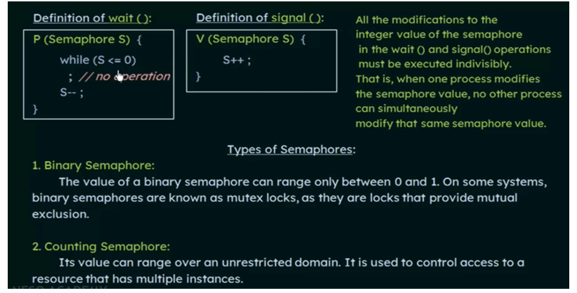
Cont..

Slide 55
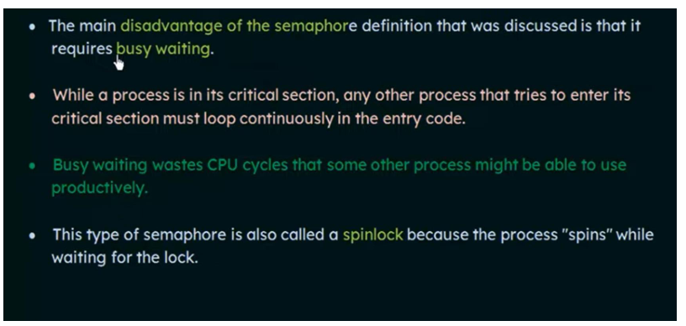
DISADVANTAGES OF SEMAPHORES

Slide 56
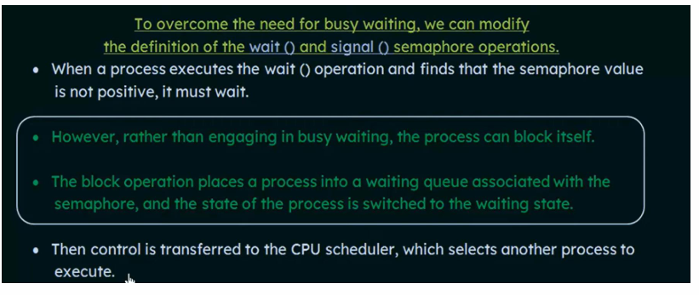
SOLUTION

Slide 57
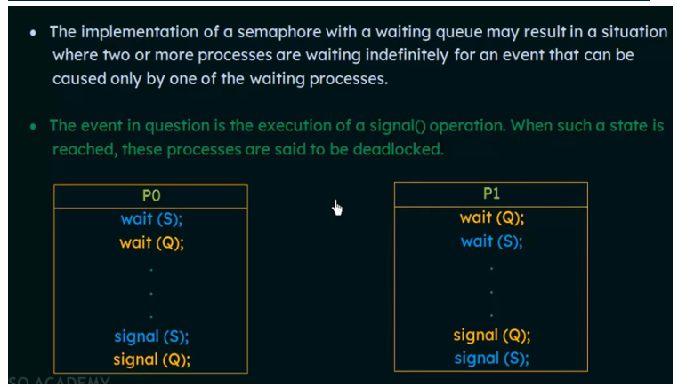
DISADVANTAGES OF SEMAPHORES: DEAD LOCKS AND STARVATION

Slide 58
Classical Problems of Synchronization
Semaphore can be used in other synchronization problems besides Mutual Exclusion. Below are some of the classical problem depicting flaws of process synchronization in systems where cooperating processes are present.
We will discuss the following three problems:
1. Bounded Buffer (Producer-Consumer) Problem
2. The Readers Writers Problem
3. Dining Philosophers Problem

Slide 59
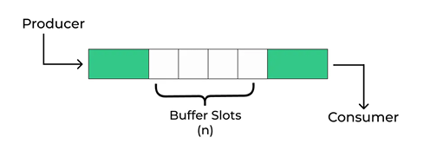
1.The Bounded-Buffer Problem
Bounded buffer problem, which is also called producer consumer problem, is one of the classic problems of synchronization.
There is a buffer of n slots and each slot is capable of storing one unit of data.
There are two processes running, namely, producer and consumer, which are operating on the buffer.
The producer tries to insert data into an empty slot of the buffer.
The consumer tries to remove data from a filled slot in the buffer.
The Producer must not insert data when the buffer is full.
The Consumer must not remove data when the buffer is empty.
The Producer and Consumer should not insert and remove data simultaneously.

Slide 60
Solution to the Bounded Buffer Problem using Semaphores
One solution of this problem is to use semaphores. The semaphores which will be used here are:
m(mutex), a binary semaphore which is used to acquire and release the lock.
empty, a counting semaphore whose initial value is the number of slots in the buffer, since, initially all slots are empty.
full, a counting semaphore whose initial value is 0.
At any instant, the current value of empty represents the number of empty slots in the buffer and full represents the number of occupied slots in the buffer.

Slide 61
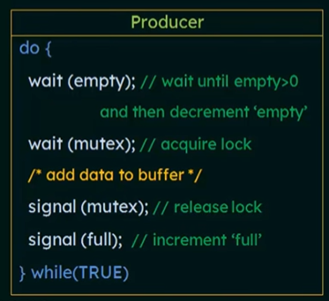
The Producer Operation
Looking at the above code for a producer, we can
see that a producer first waits until there is atleast
one empty slot.
Then it decrements the empty semaphore because,
there will now be one less empty slot, since the
producer is going to insert data in one of those slots.
Then, it acquires lock on the buffer, so that the
consumer cannot access the buffer until producer
completes its operation.
After performing the insert operation, the lock is released
and the value of full is incremented because the producer
has just filled a slot in the buffer.

Slide 62
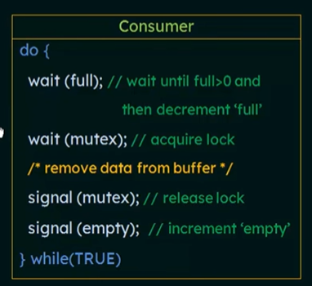
The Consumer Operation
The consumer waits until there is atleast
one full slot in the buffer.
Then it decrements the full semaphore because
the number of occupied slots will be decreased by
one, after the consumer completes its operation.
After that, the consumer acquires lock on the buffer.
Following that, the consumer completes the removal
operation so that the data from one of the full slots
is removed.
Then, the consumer releases the lock.
Finally, the empty semaphore is incremented by 1,
because the consumer has just removed data from an
occupied slot, thus making it empty.

Slide 63
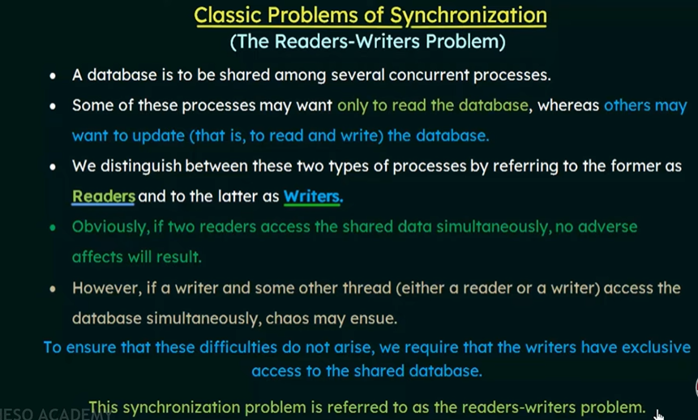
2. READERS-WRITERS PROBLEM

Slide 64
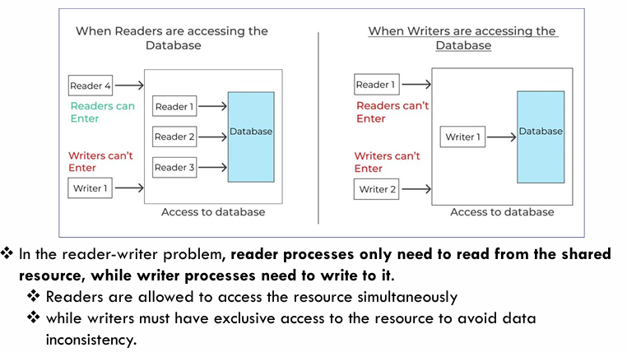
Cont..

Slide 65

Cont..

Slide 66

Cont..

Slide 67
3. DINING PHILOSOPHERS PROBLEM
The dining philosophers problem is a classic synchronization problem involving the allocation of limited resources amongst a group of processes in a deadlock-free and starvation-free manner:
Consider five philosophers sitting around a table, in which there are five chopsticks evenly distributed and an endless bowl of rice in the center, as shown in the diagram below. ( There is exactly one chopstick between each pair of dining philosophers. )
These philosophers spend their lives alternating between two activities: eating and thinking.
When it is time for a philosopher to eat, it must first acquire two chopsticks - one from their left and one from their right.
When a philosopher thinks, it puts down both chopsticks in their original locations.

Slide 68

Cont..

Slide 69

Cont..

Slide 70

Cont..
One possible solution, as shown in the following
code section, is to use a set of five semaphores
(chopsticks[ 5 ] ), and to have each hungry philosopher
first wait on their left chopstick ( chopsticks[ i ] ), and
then wait on their right chopstick ( chopsticks[ ( i + 1 ) % 5 ])
But suppose that all five philosophers get hungry at
the same time, and each starts by picking up their left
chopstick. They then look for their right chopstick, but
because it is unavailable, they wait for it, forever, and
eventually all the philosophers starve due to the
resulting deadlock.

Slide 71

Cont..

Slide 72

Cont..

Slide 73
MONITORS
A high level abstraction that provides a convenient and effective mechanism for process synchronization.
A monitor type presents a set of programmer-defined operations that provide mutual exclusion within the monitor.
The monitor type also contains the declaration of variables whose values define the state of an instance of that type, along with the bodies of procedures or functions that operate on those variables.
A monitor is essentially a class, in which all data is private, and with the special restriction that only one method within any given monitor object may be active at the same time.
An additional restriction is that monitor methods may only access the shared data within the monitor and any data passed to them as parameters. I.e. they cannot access any data external to the monitor.
It makes the parallel programming easy, and if monitors are used, then there is less error-prone as compared to the semaphore.

Slide 74

Cont..

Slide 75
COMPONENTS OF A MONITOR
There are four main components of the monitor:
Initialization: - Initialization comprises the code, and when the monitors are created, we use this code exactly once.
Private Data:- Private data is another component of the monitor. It comprises all the private data, and the private data contains private procedures that can only be used within the monitor. So, outside the monitor, private data is not visible.
Monitor Procedure:- Monitors Procedures are those procedures that can be called from outside the monitor.
Monitor Entry Queue: - Monitor entry queue is another essential component of the monitor that includes all the threads, which are called procedures.

Slide 76

Cont..
Figure shows a schematic of a monitor, with an entry queue of processes waiting their turn to execute monitor operations ( methods. )
In order to fully realize the potential of monitors, we need to introduce one additional new data type, known as a condition.

Slide 77

Cont..

Slide 78
Cont..
There are two types of operations that we can perform on the condition variables of the monitor:
1.Wait
2.Signal
Suppose there are two condition variables
condition x,y // Declaring variable
Wait Operation
x.wait(): - The process that performs wait operation on the condition variables are suspended and locate the suspended process in a block queue of that condition variable.
Signal Operation
x.signal() : - If a signal operation is performed by the process on the condition variable, then a chance is provided to one of the blocked processes.

Slide 79

Cont..

Slide 80

DEADLOCKS
A process in operating systems uses different resources and uses resources in following way.
1) Requests a resource
2) Use the resource
3) Releases the resource
Deadlock is a situation where a set of processes are blocked because each process is holding a resource and waiting for another resource acquired by some other process.
when there are two or more processes hold some resources and wait for resources held by other(s). For example, in the below diagram, Process 1 is holding Resource 1 and waiting for resource 2 which is acquired by process 2, and process 2 is waiting for resource 1.

Slide 81
Necessary Conditions
There are four conditions that are necessary to achieve deadlock:
Mutual Exclusion - At least one resource must be held in a non-sharable mode; If any other process requests this resource, then that process must wait for the resource to be released.
Hold and Wait - A process must be simultaneously holding at least one resource and waiting for at least one resource that is currently being held by some other process.
No preemption - Once a process is holding a resource ( i.e. once its request has been granted ), then that resource cannot be taken away from that process until the process voluntarily releases it.
Circular Wait - A set of processes { P0, P1, P2, . . ., PN } must exist such that every P[ i ] is waiting for P[ ( i + 1 ) % ( N + 1 ) ]. ( Note that this condition implies the hold-and-wait condition, but it is easier to deal with the conditions if the four are considered separately.

Slide 82
Resource-Allocation Graph
In some cases deadlocks can be understood more clearly through the use of Resource-Allocation Graphs, having the following properties:
A set of resource categories, { R1, R2, R3, . . ., RN }, which appear as square nodes on the graph. Dots inside the resource nodes indicate specific instances of the resource. ( E.g. two dots might represent two laser printers. )
A set of processes, { P1, P2, P3, . . ., PN }
Request Edges - A set of directed arcs from Pi to Rj, indicating that process Pi has requested Rj, and is currently waiting for that resource to become available.
Assignment Edges - A set of directed arcs from Rj to Pi indicating that resource Rj has been allocated to process Pi, and that Pi is currently holding resource Rj.
Note that a request edge can be converted into an assignment edge by reversing the direction of the arc when the request is granted. ( However note also that request edges point to the category box, whereas assignment edges emanate from a particular instance dot within the box. )

Slide 83

Cont..
For example:
If a resource-allocation graph contains no cycles, then the system is not deadlocked. ( When looking for cycles, remember that these are directed graphs. )
If a resource-allocation graph does contain cycles AND each resource category contains only a single instance, then a deadlock exists.
If a resource category contains more than one instance, then the presence of a cycle in the resource-allocation graph indicates the possibility of a deadlock, but does not guarantee one. Consider, for example

Slide 84

Cont..

Slide 85
Methods for Handling Deadlocks
There are three ways of handling deadlocks:
1. Deadlock prevention or avoidance - Do not allow the system to get into a deadlocked state.
2. Deadlock detection and recovery - Abort a process or preempt some resources when deadlocks are detected.
3. Ignore the problem all together - If deadlocks only occur once a year or so, it may be better to simply let them happen and reboot as necessary than to incur the constant overhead and system performance penalties associated with deadlock prevention or detection. This is the approach that both Windows and UNIX take.
In order to avoid deadlocks, the system must have additional information about all processes. In particular, the system must know what resources a process will or may request in the future.
• Deadlock detection is fairly straightforward, but deadlock recovery requires either aborting processes or preempting resources, neither of which is an attractive alternative.
• If deadlocks are neither prevented nor detected, then when a deadlock occurs the system will gradually slow down, as more and more processes become stuck waiting for resources currently held by the deadlock and by other waiting processes. Unfortunately this slowdown can be indistinguishable from a general system slowdown when a real-time process has heavy computing needs.

Slide 86
Deadlock Prevention
Deadlocks can be prevented by preventing at least one of the four required conditions:
Mutual Exclusion
Shared resources such as read-only files do not lead to deadlocks.
Unfortunately some resources, such as printers and tape drives, require exclusive access by a single process.
Hold and Wait
To prevent this condition processes must be prevented from holding one or more resources while simultaneously waiting for one or more others. There are several possibilities for this:
  Require that all processes request all resources at one time. This can be wasteful of system resources if a process needs one resource early in its execution and doesn't need some other resource until much later.
  Require that processes holding resources must release them before requesting new resources, and then re-acquire the released resources along with the new ones in a single new request. This can be a problem if a process has partially completed an operation using a resource and then fails to get it re-allocated after releasing it.
  Either of the methods described above can lead to starvation if a process requires one or more popular resources.

Slide 87
Cont..
No Preemption
Preemption of process resource allocations can prevent this condition of deadlocks, when it is possible.
  One approach is that if a process is forced to wait when requesting a new resource, then all other resources previously held by this process are implicitly released, ( preempted ), forcing this process to re-acquire the old resources along with the new resources in a single request, similar to the previous discussion.
  Another approach is that when a resource is requested and not available, then the system looks to see what other processes currently have those resources and are themselves blocked waiting for some other resource. If such a process is found, then some of their resources may get preempted and added to the list of resources for which the process is waiting.
  Either of these approaches may be applicable for resources whose states are easily saved and restored, such as registers and memory, but are generally not applicable to other devices such as printers and tape drives.

Slide 88
Cont..
Circular Wait
One way to avoid circular wait is to number all resources, and to require that processes request resources only in strictly increasing ( or decreasing ) order.
In other words, in order to request resource Rj, a process must first release all Ri such that i >= j.
One big challenge in this scheme is determining the relative ordering of the different resources

Slide 89
DEADLOCK AVOIDANCE
Requires that the system has some additional a priori information available
• Simplest and most useful model requires that each thread declare the maximum number of resources of each type that it may need
• The deadlock-avoidance algorithm dynamically examines the resource allocation state to ensure that there can never be a circular-wait condition
• Resource-allocation state is defined by the number of available and allocated resources, and the maximum demands of the processes

Slide 90
SAFE STATE
• When a thread requests an available resource, system must decide if immediate allocation leaves the system in a safe state
• System is in safe state if there exists a sequence of ALL the threads in the systems such that for each Ti, the resources that Ti can still request can be satisfied by currently available resources + resources held by all the Tj, with j < I
• That is:
• If Ti resource needs are not immediately available, then Ti can wait until all Tj have finished
• When Tj is finished, Ti can obtain needed resources, execute, return allocated resources, and terminate
• When Ti terminates, Ti +1 can obtain its needed resources, and so on

Slide 91
BASIC FACTS
• If a system is in safe state ➔ no deadlocks
• If a system is in unsafe state ➔ possibility of deadlock
• Avoidance ➔ ensure that a system will never enter an unsafe state.

Slide 92

SAFE, UNSAFE, DEADLOCK STATE

Slide 93

Cont..

Slide 94

Cont..

Slide 95
AVOIDANCE ALGORITHMS
• Single instance of a resource type
•Use a resource-allocation graph
• Multiple instances of a resource type
• Use the Banker’s Algorithm

Slide 96
Resource-Allocation Graph Algorithm
If resource categories have only single instances of their resources, then deadlock states can be detected by cycles in the resource-allocation graphs.
In this case, unsafe states can be recognized and avoided by augmenting the resource-allocation graph with claim edges, noted by dashed lines, which point from a process to a resource that it may request in the future.
Claim edge Ti → Rj indicated that process Tj may request resource Rj; represented by a dashed line
Claim edge converts to request edge when a thread requests a resource
Request edge converted to an assignment edge when the resource is allocated to the thread
When a resource is released by a thread, assignment edge reconverts to a claim edge
Resources must be claimed a priori in the system

Slide 97

Cont..

Slide 98

Cont..
Figure - An unsafe state in a resource allocation graph

Slide 99
Cont..
Suppose that thread Ti requests a resource Rj
The request can be granted only if converting the request edge to an assignment edge does not result in the formation of a cycle in the resource allocation graph

Slide 100
BANKER’S ALGORITHM
Multiple instances of resources
Each thread must a priori claim maximum use
When a thread requests a resource, it may have to wait
When a thread gets all its resources it must return them in a finite amount of time

Slide 101
DATA STRUCTURES FOR THE BANKER’S ALGORITHM
Let n = number of processes, and m = number of resources types.
Available: Vector of length m. If available [j] = k, there are k instances of
resource type Rj available
Max: n x m matrix. If Max [i,j] = k, then process Ti may request at most k
instances of resource type Rj
Allocation: n x m matrix. If Allocation[i,j] = k then Ti is currently allocated
k instances of Rj
Need: n x m matrix. If Need[i,j] = k, then Ti may need k more instances of Rj to complete its task
Need [i,j] = Max[i,j] – Allocation [i,j]

Slide 102
SAFETY ALGORITHM
The safety algorithm is used to check whether a resource request can be granted without leading to an unsafe state, which could potentially result in a deadlock.
The algorithm simulates the allocation of resources and checks if there exists a safe sequence of processes to complete their execution.

Slide 103

Cont..

Slide 104

Example for Banker’s Algorithm

Slide 105
Cont..
Step-1 Work=Available
Finish=False
Step-2 Need[i]<=work
Available= 3 3 2
Work=Available=3 3 2
Need[i]<=work
For p0--→7 4 3<=3 3 2[False]
For p1--→1 2 2<=3 3 2[True]
So Work= Work+Allocation
3 3 2+2 0 0=5 3 2
Process p1 is completed
For p2---→6 0 0<=532[False]

Slide 106
Cont..
For p3---→0 1 1<=5 3 2[True]
So Work= Work+Allocation
=5 3 2+2 1 1=7 4 3
Process p3 is completed
For p4----→4 3 1<=7 4 3[True]
So Work= Work+Allocation
=7 4 3+0 0 2=7 4 5
Process p4 is completed
For p0---→7 4 3<=7 4 5[True]
So Work= Work+Allocation =7 4 5+0 1 0=7 5 5
Process p0 is completed
For p2--→6 0 0<=7 5 5[True]
So Work= Work+Allocation =7 5 5+3 0 2=10 5 7
Process p2 is completed
Safe State & Safe Sequence is p1,p3,p4,p0,p2

Slide 107

RESOURCE-REQUEST ALGORITHM FOR PROCESS PI

Slide 108

EXAMPLE: P1 REQUEST (1,0,2)

Slide 109

Cont..

Slide 110
DEADLOCK DETECTION
Allow system to enter deadlock state
Detection algorithm
Recovery scheme
Deadlock Detection
If deadlocks are not avoided, then another approach is to detect when they have occurred and recover somehow.
In addition to the performance hit of constantly checking for deadlocks, a policy / algorithm must be in place for recovering from deadlocks, and there is potential for lost work when processes must be aborted or have their resources preempted.

Slide 111
Single Instance of Each Resource Type
If each resource category has a single instance, then we can use a variation of the resource allocation graph known as a wait-for graph.
A wait-for graph can be constructed from a resource-allocation graph by eliminating the resources and collapsing the associated edges, as shown in the figure below.
An arc from Pi to Pj in a wait-for graph indicates that process Pi is waiting for a resource that process Pj is currently holding.

Slide 112

Cont..
As before, cycles in the wait-for graph indicate deadlocks.
This algorithm must maintain the wait-for graph, and periodically search it for cycles.

Slide 113
SEVERAL INSTANCES OF A RESOURCE TYPE
Available: A vector of length m indicates the number of available resources of each type
Allocation: An n x m matrix defines the number of resources of each type currently allocated to each thread.
Request: An n x m matrix indicates the current request of each thread. If Request [i][j] = k, then thread Ti is requesting k more instances of resource type Rj.

Slide 114

Cont..

Slide 115

Cont..

Slide 116

Cont..

Slide 117

Cont..

Slide 118
Recovery From Deadlock
There are three basic approaches to recovery from deadlock:
Inform the system operator, and allow him/her to take manual intervention.
Terminate one or more processes involved in the deadlock
Preempt resources.

Slide 119
Process Termination
Two basic approaches, both of which recover resources allocated to terminated processes:
  Terminate all processes involved in the deadlock. This definitely solves the deadlock, but at the expense of terminating more processes than would be absolutely necessary.
  Terminate processes one by one until the deadlock is broken. This is more conservative, but requires doing deadlock detection after each step.
In the latter case there are many factors that can go into deciding which processes to terminate next:
1. Process priorities.
2. How long the process has been running, and how close it is to finishing.
3. How many and what type of resources is the process holding. ( Are they easy to preempt and restore? )
4.How many more resources does the process need to complete.
5. How many processes will need to be terminated
6. Whether the process is interactive or batch.
7. ( Whether or not the process has made non-restorable changes to any resource. )

Slide 120
Resource Preemption
When preempting resources to relieve deadlock, there are three important issues to be addressed:
Selecting a victim - Deciding which resources to preempt from which processes involves many of the same decision criteria outlined above.
Rollback - Ideally one would like to roll back a preempted process to a safe state prior to the point at which that resource was originally allocated to the process. Unfortunately it can be difficult or impossible to determine what such a safe state is, and so the only safe rollback is to roll back all the way back to the beginning. ( I.e. abort the process and make it start over. )
Starvation - How do you guarantee that a process won't starve because its resources are constantly being preempted? One option would be to use a priority system, and increase the priority of a process every time its resources get preempted. Eventually it should get a high enough priority that it won't get preempted any more.

Slide 121
.
THANK YOU
Mr.B.Sai Kumar
Assistant Professor CSE Department

